Slide 1
Chapter 5
General Vector Spaces

Slide 2
5.1 Real Vector Spaces

Slide 3
Vector Space Axioms
Let V be an arbitrary non empty set of objects on which two operations are defined, addition and multiplication by scalar (number). If the following axioms are satisfied by all objects u, v, w in V and all scalars k and l, then we call V a vector space and we call the objects in V vectors.
  If u and v are objects in V, then u + v is in V
  u + v = v + u
  u + (v + w) = (u + v) + w
  There is an object 0 in V, called a zero vector for V, such that 0 + u = u + 0 = u for all u in V
  For each u in V, there is an object –u in V, called a negative of u, such that u + (-u) = (-u) + u = 0

Slide 4
Vector Space Axioms
  If k is any scalar and u is any object in V then ku is in V
  k(u+v) = ku + kv
  (k+l)(u) = ku + lu
  k(lu) = (kl)u
  1u = u
Example: r = R^{n} with the standard operation of addition and scalar multiplication is a vector space.

Slide 5
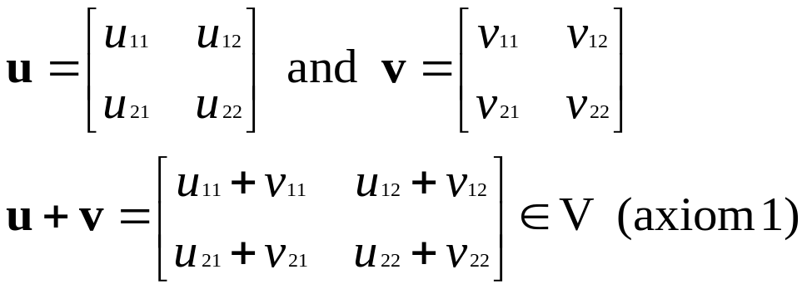
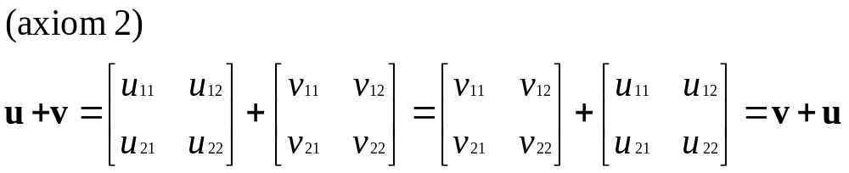
Examples of Vector Spaces
Show that the set V of all 2 x 2 matrices with real entries is vector space if vector addition is defined to be matrix addition and vector scalar multiplication is defined to be matrix scalar multiplication.

Slide 6
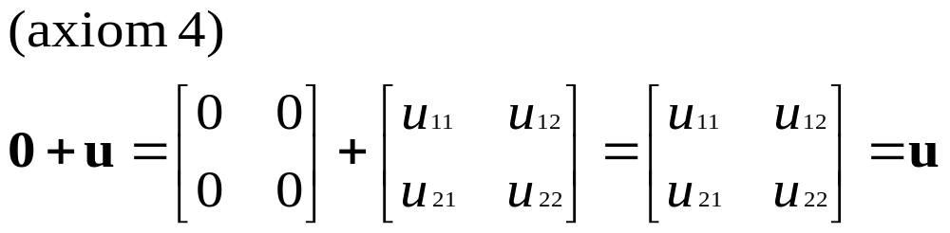
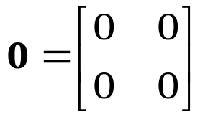
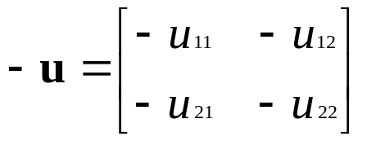
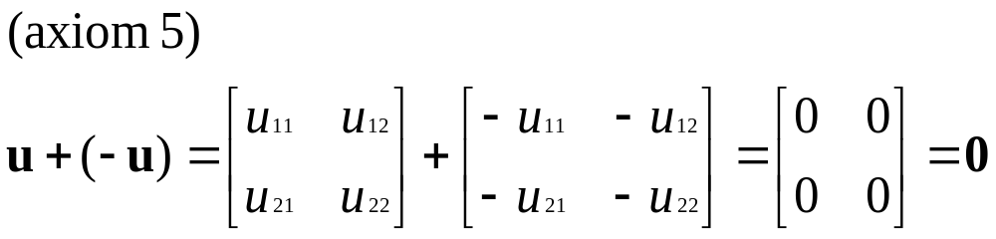
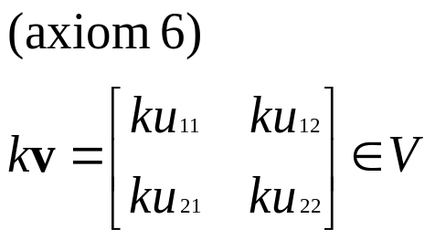
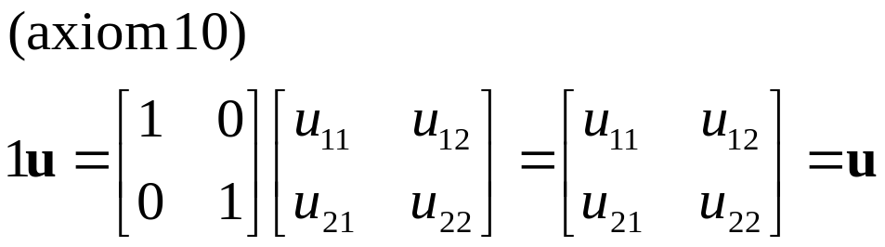
Examples of Vector Spaces

Slide 7
Examples of Vector Spaces
Vector space of mxn matrices
  The mxn zero matrix is the zero vector 0, and if u is the mxn matrix U, then the matrix –U is the negative –u of the vector u. We shall denote this vector space by the symbol M_{mn}.

Slide 8
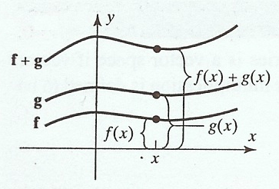
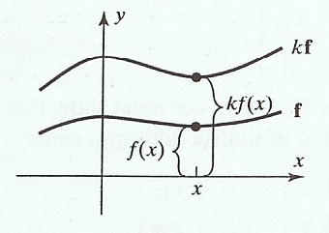
Examples of Vector Spaces
A vector space of real-valued functions
  Let V be the set of real-valued functions defined on the entire real line (-~,~). If f=f(x) and g=g(x) are two such functions and k is any real number, define function f+g and the scalar multiple kf, respectively, by

Slide 9
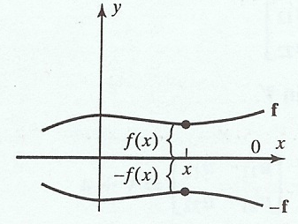
Examples of Vector Spaces
  The vector space is denoted by F(-~,~). If f and g are vectors in this space, then to say that f=g is equivalent to saying that f(x)=g(x) for all x in the interval (-~,~).
  The vector 0 in F(-~,~) is the constant function that is identically zero for all values of x. The graph of this function is
  the line that coincides
  with the x-axis.
  The negative of vector f
  is the function –f=-f(x).

Slide 10
Examples of Vector Spaces
A set that is not a vector space
  Let V=R² and define addition and scalar multiplication operations: if u=(u₁,u₂) and v=(v₁,v₂), then define:
  u+v = (u₁+v₁,u₂+v₂)
  and if k is any real number, then define
  ku = (ku₁,0)
  The addition operation is the standard addition operation on R2, but the scalar multiplication is not the standard scalar multiplication.
  Example: if u=(u₁,u₂) is such that u₂≠0, then
  1u=1(u₁,u₂)=(1.u₁,0)=(u₁,0)≠u

Slide 11
Some Properties of Vectors
Let V be a vector space, u a vector in V, and k a scalar, then:
  a) 0u = 0
  b) k0 = 0
  c) (-1)u = -u
  d) If ku = 0, then k = 0 or u = 0

Slide 12
5.2 Subspaces

Slide 13
Subspaces
Definition
  A subset W of a vector space V is called a subspace of V if W is itself a vector space under the condition and scalar multiplication defined on V
  Do we need to check the 10 axiom?

Slide 14
Subspaces
Theorem:
  If W is a set of one or more vectors from a vector space V, then W is a subset space of V iff the following conditions hold:
    If u and v are vectors in W, then u+v is in W
    If k is any scalar and u is any vector in W then ku is in W

Slide 15
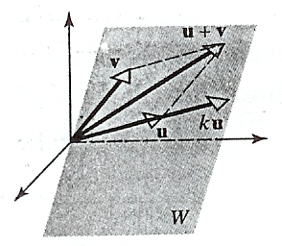
Subspaces
Testing for a subspace
  Let W be any plane through the origin and let u and v be any vectors in W. Then u+v must lie in W because it is diagonal of the parallelogram determined by u and v, and ku must lie in W for any scalar
  k because ku lies on a line
  through u. Thus, W is
  closed under addition and
  scalar multiplication, so it is
  a subspace of R³.

Slide 16
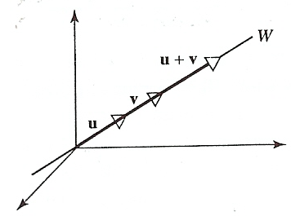
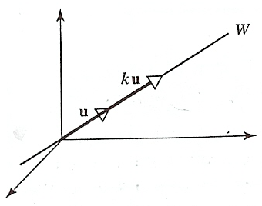
Subspaces
Lines through the origin are subspaces
  Show a line through the origin of R³ is a subspace of R³.
  Let W be a line through the origin of R³. It is evident
  geometrically that the sum of two vectors on this line also
  lies on the line and that a scalar multiple of a vector on the
  line is on the line as well. W is closed under addition and scalar multiplication, so it is a subspace of R³.

Slide 17
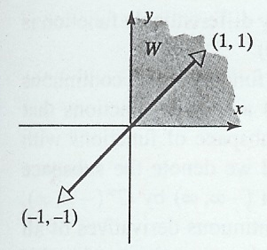
Subspaces
A subset of R2 that is not a subspace
  Let W be the set all points (x,y) in R2 such that x≥0 and y≥0 (first quadrant). The set W is not a subspace of R2 since it is not closed under scalar multiplication.
  For Example, v=(1,1) lies
  in W, but its negative
  (-1)v=-v=(-1,-1) does not

Slide 18
Subspaces
A subspace of polynomials of degree ≤ n
  Let n be a nonnegative integer, and let W consist of all functions expressible in the form
  p(x) = a₀ + a₁x + ... + a_{n}x^{n}
  Where a₀,...,a_{n} are real numbers. Thus W consists of all real polynomials of degree n or less.
  p(x) = a₀+a₁x+...+a_{n}x^{n} and q(x) = b₀ + b₁x + ... + b_{n}x^{n}
  then
  (p+q)(x)=p(x)+q(x)=(a₀+b₀)+(a₁+b₁)x+...+(a_{n}+b_{n})x_{n}
  and
  (kp)(x)=kp(x) = (ka₀)+(ka₁x)+...+(ka_{n}x^{n})

Slide 19
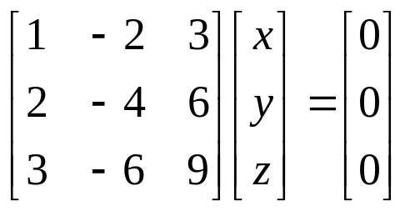
Solution Spaces of
Homogeneous Systems
If Ax = 0 is a homogeneous linear system of m equations in n unknowns, then the set of solution vectors is a subspace of R^{n}.
Example:
The solutions are x = 2s – 3t, y = s, z = t
→ x = 2y – 3z or x – 2y + 3z = 0
The equation of the plane through the origin with n = (1,-2,3) as a normal vector.

Slide 20
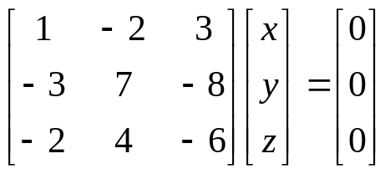
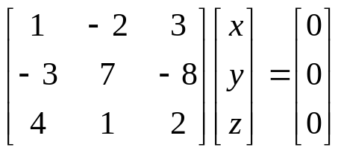
Solution Spaces of
Homogeneous Systems
Example:
x = -5t, y = -t, z = t
Parametric equations for the line through the origin parallel to the vector v = (-5,-1,1)
Example:
x = 0, y = 0, z = 0
The solution space is origin only → {0}

Slide 21
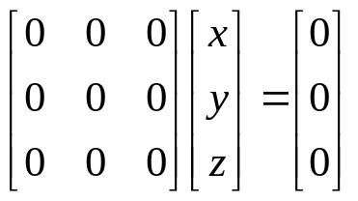

Solution Spaces of
Homogeneous Systems
Example:
x = r, y = s, z = t
where r, s, and t have arbitrary values, so the solution space is all of R³.

Slide 22
Linear Combination
A vector w is called a linear combination of the vectors v₁,v₂,..., v_{r} if it can be expressed in the form w = k₁v₁ + k₂v₂ + ... + k_{r}v_{r} where k₁, k₂, ...., k_{r} are scalars.
Example:
  Every vector v = (a, b, c) in R3 is expressible as a linear combination of the standard basis vectors i = (1,0,0), j = (0,1,0), k=(0,0,1) since
  v = (a,b,c) = a(1,0,0) + b(0,1,0) + c(0,0,1)
  = ai + bj + ck

Slide 23
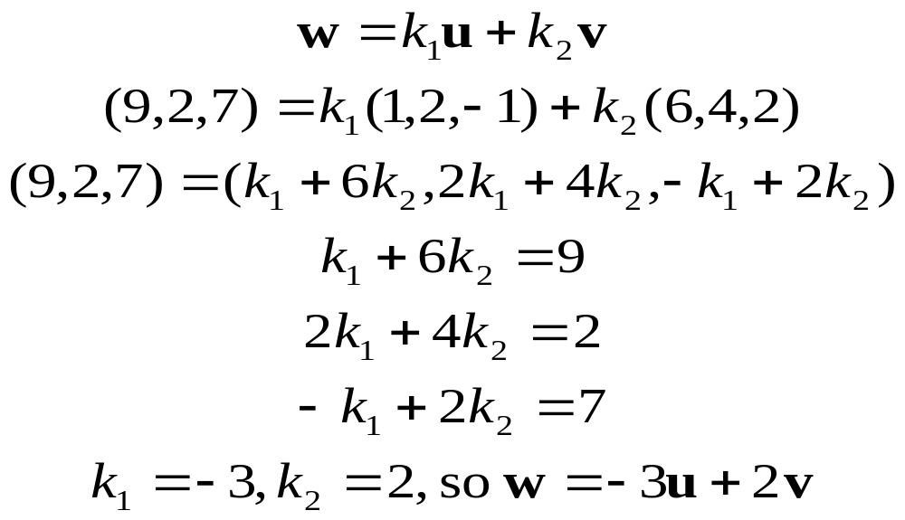
Linear Combination
Example: Consider the vectors u=(1,2,-1) and v=(6,4,2) in R³. Show that w=(9,2,7) is a linear combination of u and v and that w’=(4,-1,8) is not a linear combination of u and v.

Slide 24
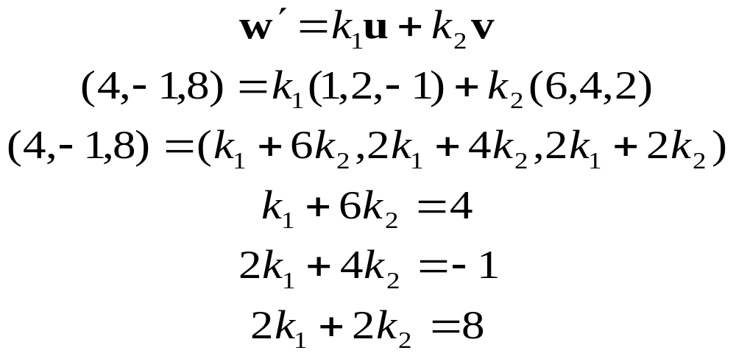
Linear Combination
System of equations is inconsistent, so no such scalar k1 and k2 exist. w’ is not a linear combination of u and v.

Slide 25
Spanning
Theorem: If v₁,v₂,..., v_{r} are vectors in a vector space V, then:
  The set W of all linear combinations of v₁, v₂,...,v_{r} is a subspace of V.
  W is the smallest subspace of V that contains v₁,v₂,...,v_{r} must contain W.
Definition: If S={v₁,v₂,...,v_{r}} is a set of vectors in a vector space V, then the subspace W of V consisting of all linear combinations of the vectors in S is called the space spanned by v₁,v₂,...,v_{r}, and we say that the vectors v₁,v₂,...,v_{r} span W. To indicate that W is the space spanned by the vectors in the set S={v₁,v₂,...,v_{r}}, write in W = span(S) or W = span{v₁,v₂,...,v_{r}}

Slide 26
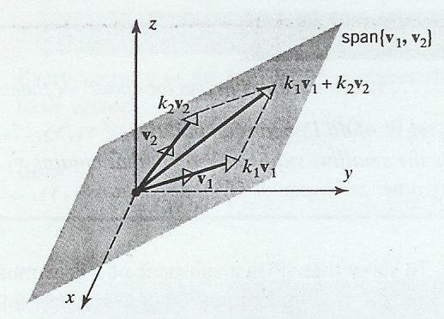
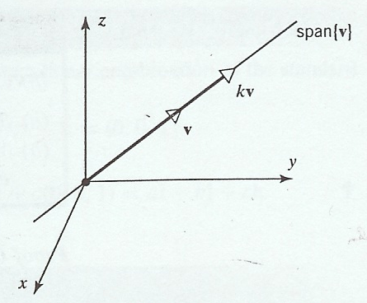
Spanning
Spaces spanned by One or Two vectors.
  If v₁ and v₂ are noncollinear vectors in R³ with their initial points at the origin, then span{v₁,v₂}, which consist of all linear combinations kv₁+kv₂, is the plane determined by v₁ and v₂. Similarly, if v is a nonzero vector in R² or R³, then span{v}, which is the set of all scalar multiples kv, is the line determined by v.

Slide 27
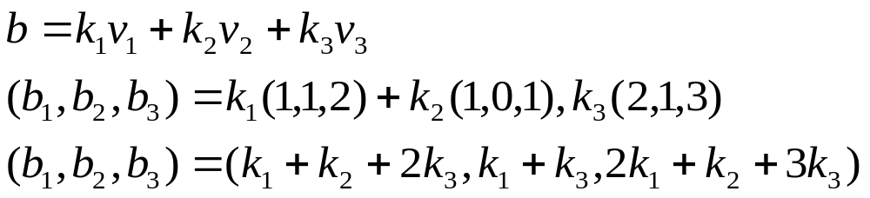
Spanning
Spanning set for P_{n}
The polynomials 1,x,x²,...,x^{n} span the vector space P_{n} since each polynomial p in P_{n} can be written as: p = a₀+a₁x+...+a_{n}x^{n}
which is a linear combination of 1,x,x²,...,x^{n}.
P_{n}=span{1,x,x²,...,x^{n}}
Three vectors that do not span R³.
Determine whether v1=(1,1,2), v2=(1,0,1), and v3=(2,1,3) span the vector space R³.

Slide 28
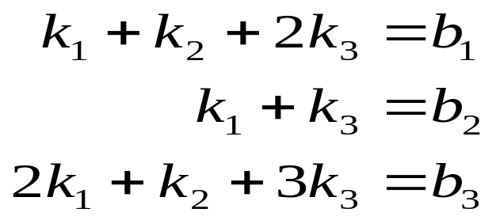
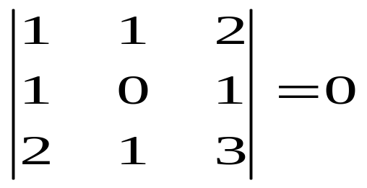
Spanning
so that v₁, v₂, and v₃ do not span R³.
Theorem: If S={v₁,v₂,...,v_{r}} and S’={w₁,w₂,...,w_{r}} are two sets of vectors in a vector space V, then
span{v₁,v₂,...,v_{r}} = span{w₁,w₂,...,w_{r}}
iff each vector in S is a linear combination of those in S’ and each vector in S’ is a linear combination of those in S.

